Slide 1
Mehran S. Fallah June 2020
Programming Languages
Session X
The Algol Family

Slide 2
Introduction
The Algol-like programming languages evolved in parallel with the Lisp family of languages, beginning with Algol 58 and Algol 60 in the late 1950s.
The most prominent Algol-like programming languages are Pascal and C.
A number of important language ideas were developed in the Algol family.
The main characteristics of the Algol family are the familiar colon-separated sequence of statements used in most languages today, block structure, functions and procedures, and static typing.
In this session, we look at some of the historically important languages from the Algol family, including Algol 60, Pascal, and C.

Slide 3
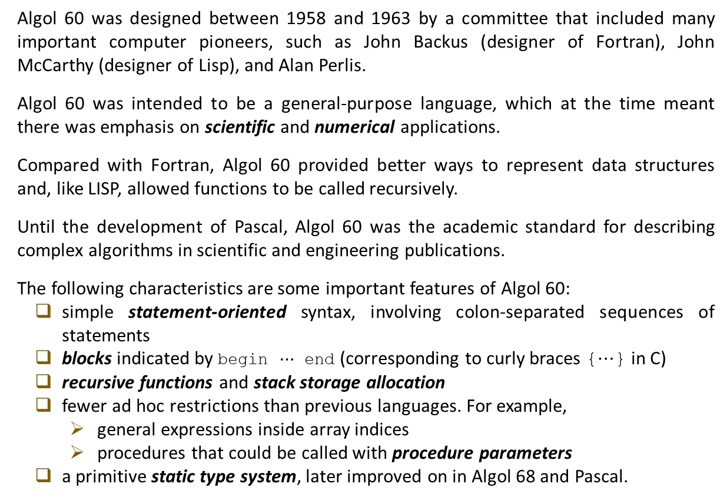
Algol 60
Algol 60 was designed between 1958 and 1963 by a committee that included many important computer pioneers, such as John Backus (designer of Fortran), John McCarthy (designer of Lisp), and Alan Perlis.
Algol 60 was intended to be a general-purpose language, which at the time meant there was emphasis on scientific and numerical applications.
Compared with Fortran, Algol 60 provided better ways to represent data structures and, like LISP, allowed functions to be called recursively.
Until the development of Pascal, Algol 60 was the academic standard for describing complex algorithms in scientific and engineering publications.
The following characteristics are some important features of Algol 60:
simple statement-oriented syntax, involving colon-separated sequences of statements
blocks indicated by begin $⋯$ end (corresponding to curly braces {$⋯$} in C)
recursive functions and stack storage allocation
fewer ad hoc restrictions than previous languages. For example,
general expressions inside array indices
procedures that could be called with procedure parameters
a primitive static type system, later improved on in Algol 68 and Pascal.

Slide 4
Algol 60 (Ctd.)
Here is an example program of Algol 60.
The two-character sequence := is used for assignment, and the single character = for test for equality
The types of the parameters to the procedure (function) are declared in the line following the procedure name.
Although A is declared to be a real array, no array bounds are given as part of the declaration.
The return value of the procedure is given when a value is assigned to the name of the procedure.
An irritating syntactic peculiarity of Algol 60 is the way that semicolons must be (and must not be) used between statements. In particular, it would be a syntactic error to place a semicolon after the last assignment and before the keyword end.
real procedure average(A,n);
real array A; integer n;
begin
real sum; sum := 0;
for i = 1 step 1 until n do
sum := sum + A[i];
average := sum/n
end;

Slide 5
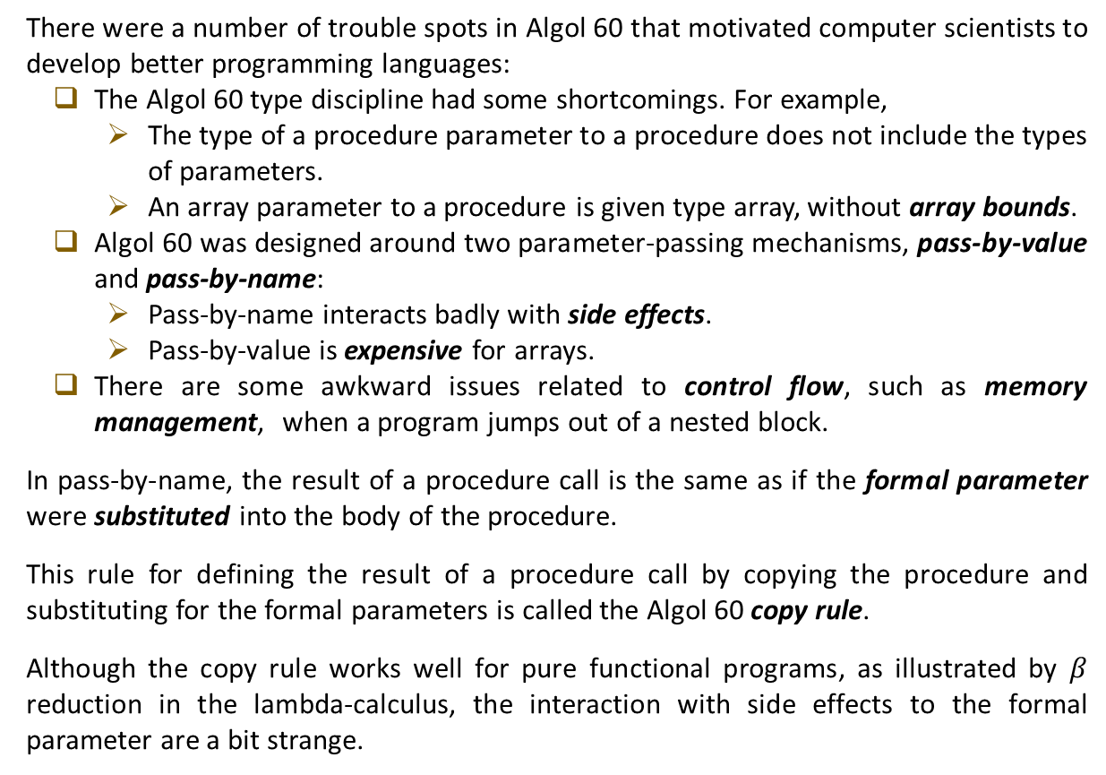
Algol 60 (Ctd.)
There were a number of trouble spots in Algol 60 that motivated computer scientists to develop better programming languages:
The Algol 60 type discipline had some shortcomings. For example,
The type of a procedure parameter to a procedure does not include the types of parameters.
An array parameter to a procedure is given type array, without array bounds.
Algol 60 was designed around two parameter-passing mechanisms, pass-by-value and pass-by-name:
Pass-by-name interacts badly with side effects.
Pass-by-value is expensive for arrays.
There are some awkward issues related to control flow, such as memory management, when a program jumps out of a nested block.
In pass-by-name, the result of a procedure call is the same as if the formal parameter were substituted into the body of the procedure.
This rule for defining the result of a procedure call by copying the procedure and substituting for the formal parameters is called the Algol 60 copy rule.
Although the copy rule works well for pure functional programs, as illustrated by $β$ reduction in the lambda-calculus, the interaction with side effects to the formal parameter are a bit strange.

Slide 6
Algol 60 (Ctd.)
Here is an example program showing a technique referred to as Jensen’s device: passing an expression and a variable it contains to a procedure so that the procedure can use one parameter to change the location referred to by the other:
The procedure sum(i,j) adds up the values of j as i goes from 1 to 100.
The procedure makes no sense unless changes to i cause some change in the value of j; otherwise, the procedure just computes 100∗j.
In the call sum(i,i∗10) shown here, the for loop in the body of procedure sum adds up the value of i∗10 as i goes from 1 to 100, that is 10∗50∗101.
begin integer i;
integer procedure sum(i, j);
integer i, j;
comment parameters passed by name;
begin integer sm; sm := 0;
for i = 1 step 1 until 100 do sm := sm + j;
sum := sm
end;
print(sum(i, i*10 ))
end

Slide 7
Algol 68
Algol 68 was intended to remove some of the difficulties found in Algol 60 and to improve the expressiveness of the language. However, in the end, the Algol 68 committee produced a design that was more problematic than that of Algol 60.
One main problem is that, although programming in Algol 68 appears no more difficult than that of Algol 60, some features of Algol 68 made it difficult to compile efficiently.
One source of difficulty was the combination of procedure parameters and procedure return values, which was not well understood at the time (higher-order functions.)
Another reason that Algol 68 was not entirely successful was that the authors chose to define entirely new terminology for the language and its documentation. This made it difficult for programmers to move from Algol 60 to Algol 68.
One contribution of Algol 68 was its regular, systematic type system. For some reason, the Algol 68 designers chose to call types modes. The modes of Algol 68 are either primitive or compound modes. The primitive modes included int, real, char, bool, string, complex, bits, bytes, semaphore, format (for input and output), and file. The compound modes include modes formed with the forms array, structure, procedure, set, and pointer.

Slide 8
Algol 68 (Ctd.)
In Algol 68, type constructions can be combined without restriction, so that a programmer can build an array of pointers to procedures, for example.
The decision to allow unrestricted combinations of the mode constructors made the type system seem more systematic than previous languages.
Some other advances in Algol 68 were in the areas of memory management and parameter passing. Algol 68 memory management involves a stack for local variables and heap storage for data that are intended to live beyond the current function call.
As in C, Algol 68 data on the heap are explicitly allocated, but unlike C, heap data are reclaimed by garbage collection. This combination of explicit allocation and garbage collection carried over into Pascal.
Algol 68 parameter passing is pass-by-value, with pass-by-reference accomplished by pointer types. This is essentially the same design as that adopted in C some years later.
The decision to allow independent constructs to be combined without restriction also led to some complex features, such as assignable procedure variables.

Slide 9
Pascal
Pascal was designed in the 1970s by Niklaus Wirth, who used the data-structuring ideas advanced by C. A. R. (Tony) Hoare.
Pascal was significantly simpler than Algol 68 and achieved more widespread acceptance than either Algol 60 or Algol 68. Pascal was one of the most widely used programming languages over approximately a 20-year period.
Pascal was also used for a significant number of production programming projects, including operating systems and applications for the Apple Macintosh.
The Pascal type system is more expressive than the Algol 60 type system and simpler and more limited than that of Algol 68 eliminating some of its compilation difficulties.
An important contribution of the Pascal type system is the rich set of data structuring concepts. These include records (similar to C structs), variant records (a form of union type), and subranges. A restriction that made Pascal simpler than Algol 68 was that procedure parameters could not be procedures with procedure parameters.
Allowed
procedure DoSomething( j,k : integer );
procedure DoSomething( procedure P(i:integer); j, k : integer);
Not Allowed
procedure NotAllowed( procedure MyProc( procedure P(i:integer)));

Slide 10
Pascal (Ctd.)
One place where Wirth’s focus on teaching and on systematic language design caused a small problem was in the typing of array parameters. In Pascal, the type of an array has the form
where <indexType> is often a subrange type.
This definition of array type allows a procedure declaration such as
where the argument to the procedure is an array of some array type, but does not allow
as array [1..n] of integer is not considered a legal type in Pascal.
This is an unfortunate limitation. If we want to sort arrays of several different lengths, then Pascal (as originally designed) would make it necessary to copy over the procedure several times, changing the array length in each copy.
Not only is this awkward, it is also unnecessary because the memory associated with an array is already allocated before it is passed to any procedure. Therefore there is no reason, other than type checking, for a procedure to allow array parameters of only a fixed length.
array <indexType> of <entryType>
procedure p(a : array [1..10] of integer)
procedure p(n: integer, a : array [1..n] of integer)

Slide 11
C
Although Pascal was a successful academic and teaching language, C eventually eclipsed Pascal as a production programming language.
There are several reasons for the success of C:
One reason, which is unrelated to the design of the language itself, is the popularity of the Unix operating system, which was written in C. When programs are written to run under Unix, all of the basic system calls are immediately available in C.
Another reason for the popularity of C is that it has a distinctive memory model that is close to the underlying hardware.
Although C has many of the same concepts as Pascal, C is less rigid in its enforcement of basic principles and restrictions.
C was originally designed and implemented from 1969 to 1973, as part of the Unix operating system project at Bell Laboratories. The design evolved from Ritchie’s and Thompson’s B language, which was in turn based on a language called BCPL.
Significant changes in C occurred from 1977 to 1979, as part of a push to achieve portability of the Unix system, and in the mid-1980s when committee of the American National Standards Institute (ANSI) standardized the language.
The main difference between B and C is that B was untyped whereas the C language has types and type-checking rules.

Slide 12
C (Ctd.)
One characteristic that distinguishes C from other popular languages is the treatment of memory locations, arrays, and pointers.
This part of C is inherited from BCPL and B. The only data type in B is the “word,” or “cell,” a fixed-length bit pattern.
Memory in BCPL and B is presented to the programmer as a linear array of words. Pointers are treated as integer indices into this array, and programmer-declared arrays are treated as contiguous words drawn from the larger array of all memory words.
This view has several consequences:
One is that arrays and pointers are largely equivalent.
Another consequence is that, because pointers are integer indices in the memory array, pointer arithmetic is considered meaningful: If p is the address of a memory location, then p+1 is the address of the next location.
In C, pointers and arrays are declared differently, as if pointers and arrays are different types of values. For example, the following code declares a pointer p to an integer location and an array A of integers:
int * p;
int A[5];

Slide 13
C (Ctd.)
In most languages, there is some operation for dereferencing a pointer. Dereferencing is the operation that returns the location pointed to by the pointer.
In most languages with arrays, there is an indexing operation that can be used to find one of the locations within the array.
There are some similarities between these two operations, but most typed languages (including others in the Algol family) would consider dereferencing an array name or indexing a pointer illegal.
In C, however, arrays are effectively treated as pointers. To quote Dennis Ritchie’s 1975 C Reference Manual,
“Every time an identifier of array type appears in an expression, it is converted into a pointer to the first member of the array …. By definition, the subscript operator [ ] is interpreted in such a way that E1[E2] is identical to ∗((E1)+(E2)). Because of the conversion rules which apply to +, if E1 is an array and E2 is an integer, then E1[E2] refers to the E2-th member of E1.”

Slide 14
C (Ctd.)
An important feature of C has been the tolerance of C compilers to type errors. This is partly because C evolved from untyped languages.
Although some C programmers have liked the ability to write and compile programs with type errors, most C programmers have eventually come to consider the weak type checking of many C compilers to be a disadvantage.
In fact, one of the most commonly cited advantages of C++ over C is the fact that C++ provides better type checking.
As Dennis Ritchie says,
Although accidents of history surely helped, C evidently satisfied a need for a system implementation language efficient enough to displace assembly language, yet sufficiently abstract and fluent to describe algorithms and interactions in a wide variety of environments.
C is quirky, flawed, and an enormous success.

Slide 15
Concepts in Programming Languages (Chapter 5)

